Slide 1
Building Applications with Freestyle Projects

Slide 2




Anatomy of the Build
Workspace Folder
Git Repo
Clean
Compile
Test
Package

Slide 3











Manual -> Jenkins
Workspace Folder
Git Repo
Clean
Compile
Test
Package

Slide 4
Workspaces are Temporary

Slide 5
Artifacts are Forever

Slide 6







Anatomy of the Build
Workspace Folder
Git Repo
Clean
Compile
Test
Package

Slide 7

Anatomy of the Build
Workspace Folder
Git Repo
Clean
Compile
Test
Package

Slide 8
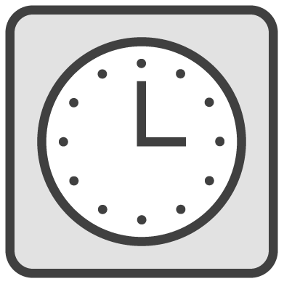
Anatomy of the Build
Workspace Folder
Git Repo
Clean
Compile
Test
Package

